Slide 1
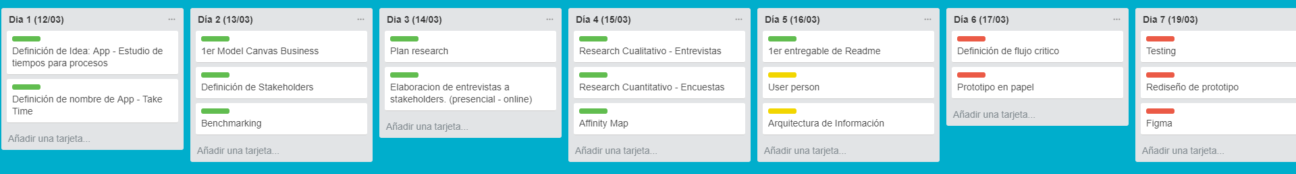

Slide 2
Definición de actividades
Model Business Canvas
Stakeholders
Benchmarking
Plan Research

Slide 3
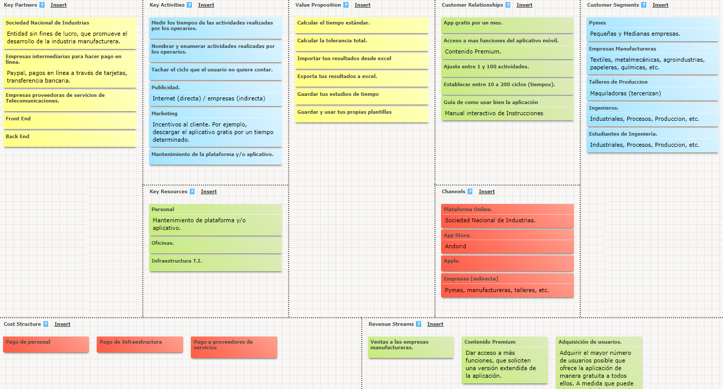

Slide 4
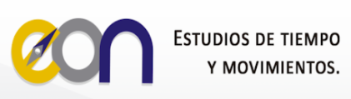
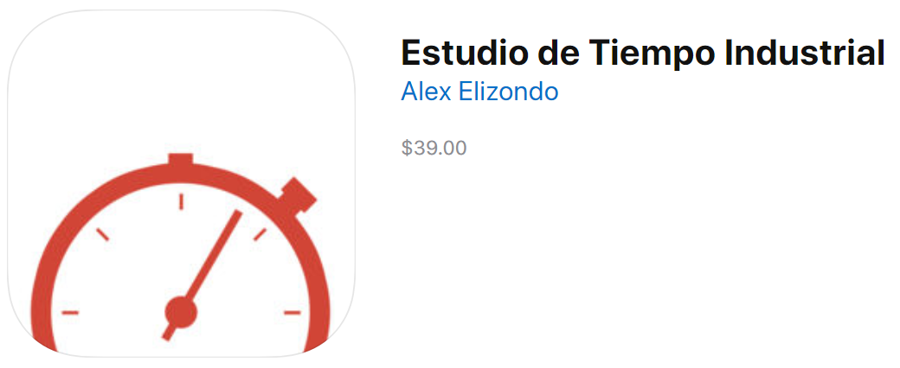

Slide 5
